Slide 1
Joint Distribution
Lecture 3
By
C B Gupta

Slide 2
Conditional Densities.
Conditional densities will be defined as follows:
Let (X,Y) be a two dimensional random variable with joint density f_{xy}(x,y) and marginal densities f_{x}(x) and f_{y}(y) of X and Y respectively, then

Slide 3
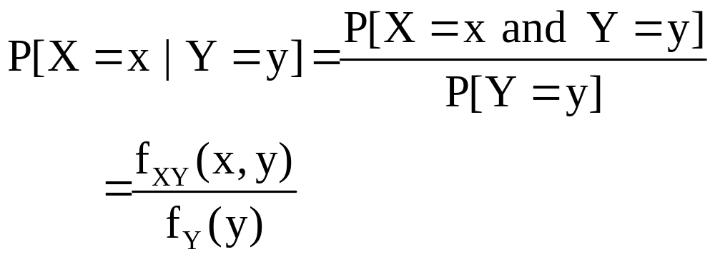
Conditional Densities:
The conditional density for X given Y=y
denoted by f_{X|y},

Slide 4
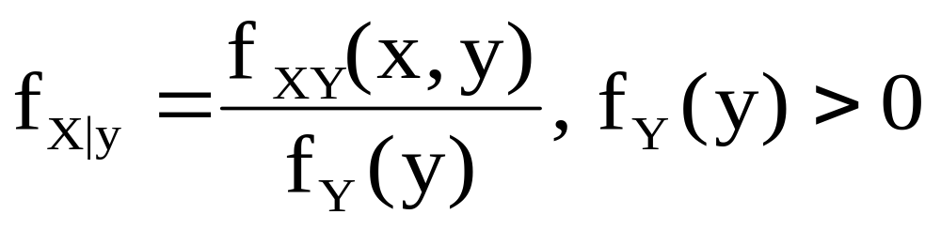
Def: Let (X,Y) be a two dimensional
random variable with joint density f_{XY}
and marginal densities f_{X} and f_{Y}. Then
The conditional density for X given
given Y= y, denoted by f_{X|y} is given by:

Slide 5
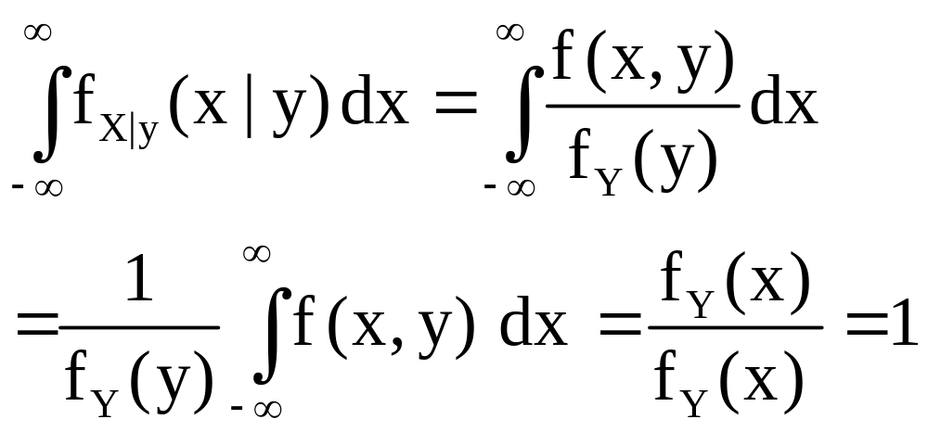
Note: The conditional densities satisfies
all the requirements for a one dimensional
pdf. Thus for a fixed y, we have f_{X|y}(x|y)≥0
and

Slide 6
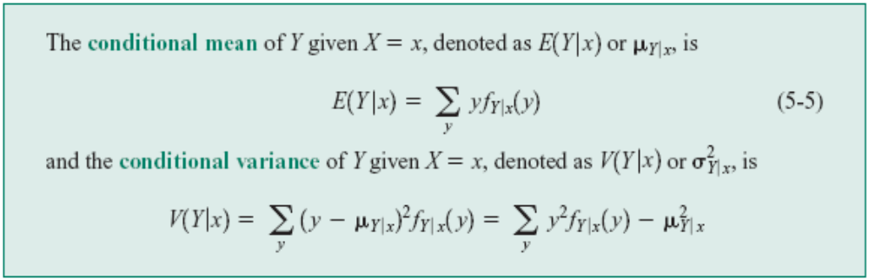
Definition: Conditional Mean and Variance

Slide 7
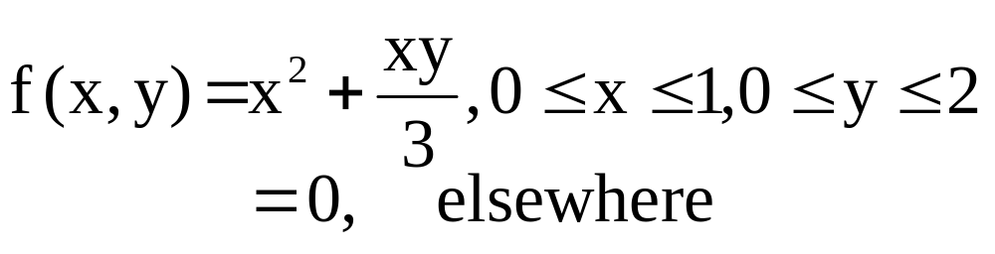
Example: Suppose that the two dimensional
continuous random variable (X,Y) has joint pdf given by:
The marginal density of X is:

Slide 8
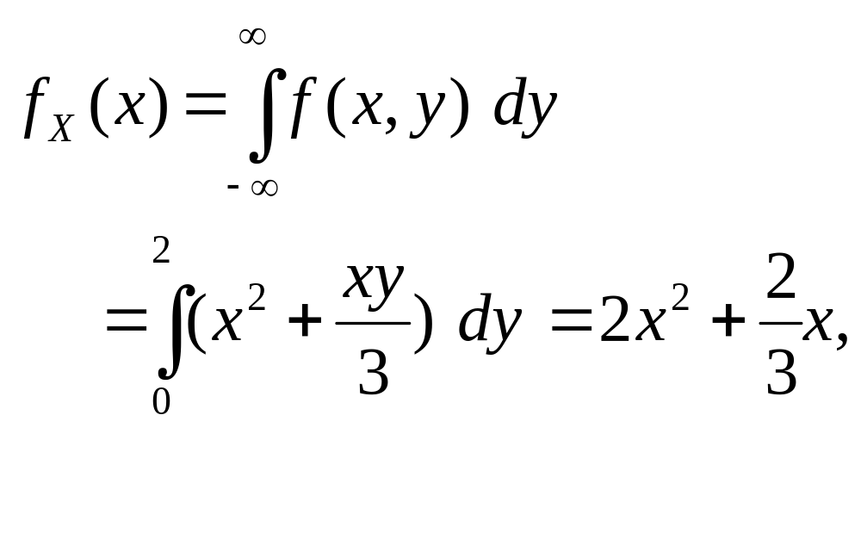
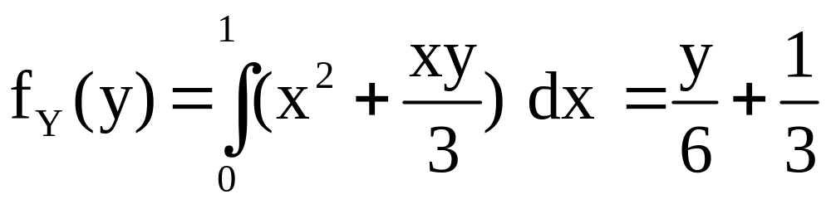
The marginal density for Y is:

Slide 9
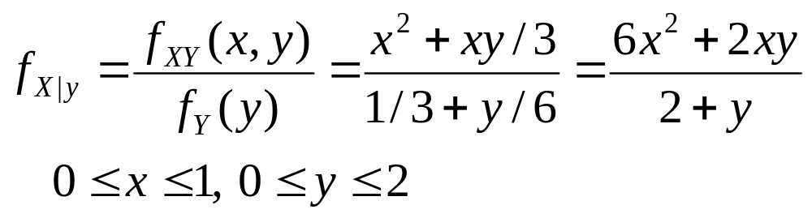
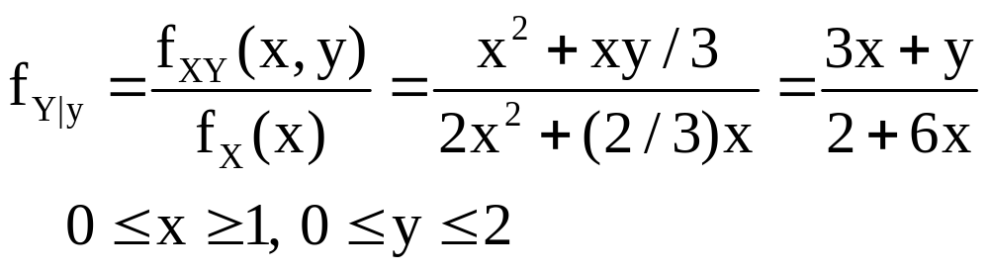
The conditional density of X given y is:
The conditional density of Y given x is:

Slide 10
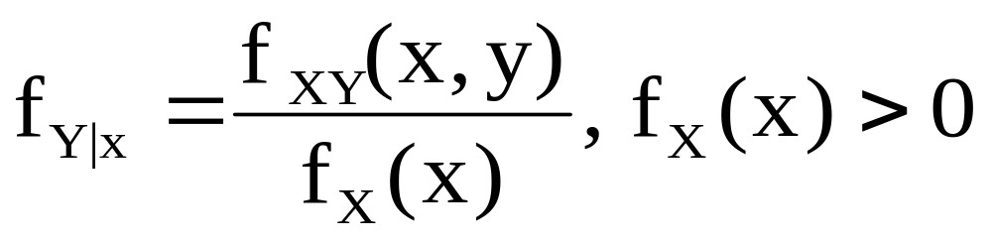
2. The conditional density for X given
given Y=y, denoted by f_{X|y} is given by:
Review Exercise : (Page No: 188)
54. An electronic device is designed to
switch house lights on and off at random
times after it has been activated.Assume

Slide 11
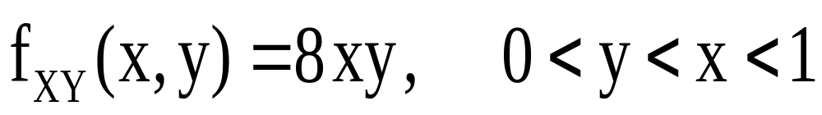
that the device is designed in such a way
that it will be switched on and off exactly
once in a 1- hour period. Let Y denote the
time at which the lights are turned on and X the time at which they are turned off. Assume that the joint density for (X,Y) is
given by

Slide 12
(a ) Verify that f_{XY} satisfies the conditions
necessary to be a density.
(b) Find E[XY]
(c ) Find the probability that the lights will
be switched on within ½ hour after being
activated and then switched off again
within 15 minutes.
(d) Find the marginal density for X. Find
E[X] and E[X²].

Slide 13
Find the marginal density for Y. Find
E[Y] and E[Y²].
(f) Are X and Y independent?
(g) Find the conditional distribution of X
given Y
(h) Find the probability that the lights will
be switched off within 45 minutes of the
system being activated given that they were switched on 10 minutes after the system was activated.

Slide 14
Let X denote the number of “do loops”
in a Fortran program and Y the number of
Runs needed to debug the program. Assume
that the joint density for (X,Y) is given as:
x/y
1
2
3
4
0.59
0.100
0.050
0.001
0
0.082
0.003
1
0.093
0.120
0.102
0.100
0.010
0.065
2
0.075
0.070
0.020
3
0.050

Slide 15
Find the probability that a randomly
selected program contains at most one
do loop and requires at least two runs to
debug the program
(b) Find E[XY]
(c ) Find the marginal densities for X and
Y. Use these to find the mean and
variance for both X and Y
(d) Find the probability that a randomly
selected program requires at least

Slide 16
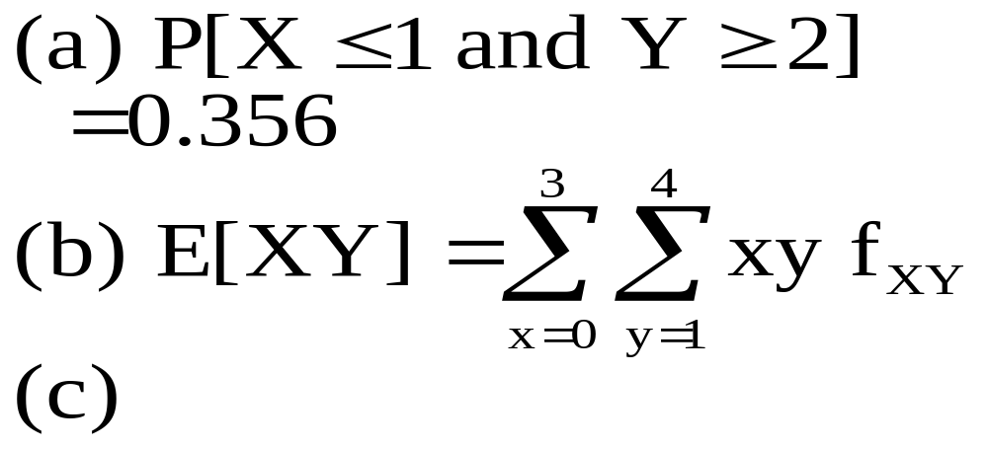
two runs to debug given that it contains
exactly one “doloop”
(e) Find Cov(X,Y)
Sol:

Slide 17
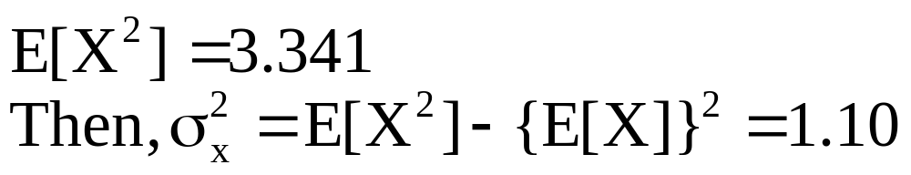
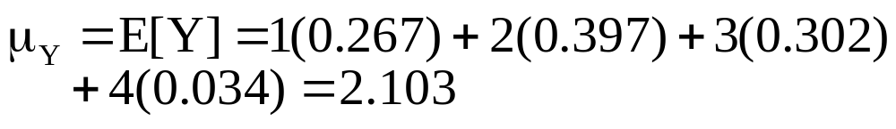
 | 0 | 1 | 2 | 3
f_{x}(x) | 0.210 | 0.298 | 0.277 | 0.215
x
y | 0 | 1 | 2 | 3
f_{Y}(x) | 0.267 | 0.397 | 0.302 | 0.034

Slide 18
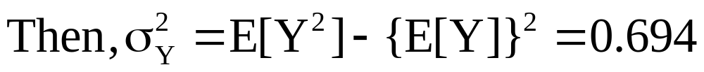
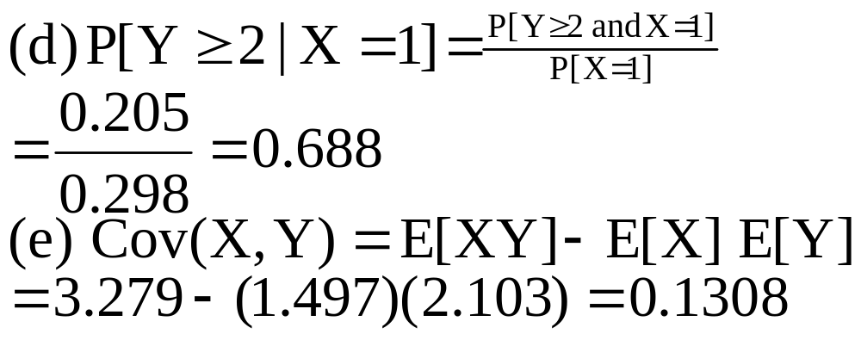

Slide 19
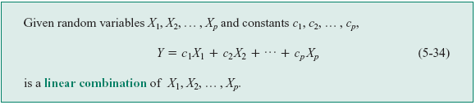
Mean and variance of Linear Combination of random variables

Slide 20

Mean of Linear Combination

Slide 21
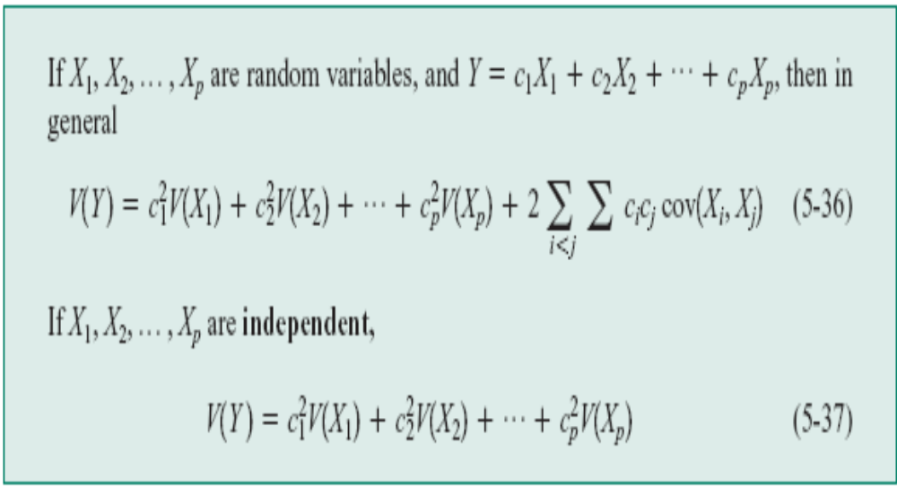
Variance of Linear Combination of Random Variables

Slide 22
Example:
Let X and Y be independent random variables with mean 7 and -5 respectively and variance 9 and 3 respectively. Find
(i) E(4X-2Y+6) and
(ii) V(4X-2Y+6)

Slide 23
Solution:
Given E(X) = 7, E(Y) = -5 and
  Var X = 9, Var Y = 3 and also X and Y are independent random variables.
(i) E(4X-2Y=6) = 4 E(X) – 2 E(Y) + 6
4.7+(-2).(-5)+6 =44
(ii) Var(4X-2Y+6) =4² .Var X + (-2)^{2.}Var Y
16.9 + 4.3 = 156 ( var of a constant=0)

